Slide 1
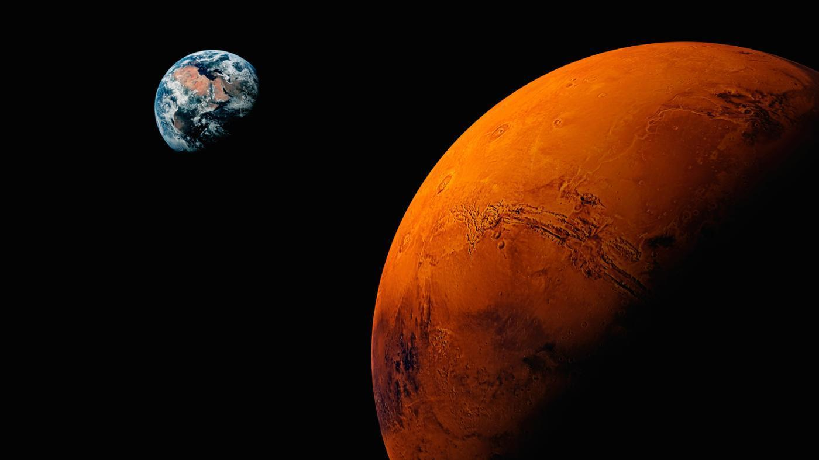

Analysis of the Impacts of Geology and Fluvial Processes on the Development of Drainage Networks on the Tharsis Volcanic Region, Mars
Alexander Danielson
Supervisor: Miriam Rios-Sanchez
Center for Environmental, Economic, Earth and Space Studies
Bemidji State University

Slide 2
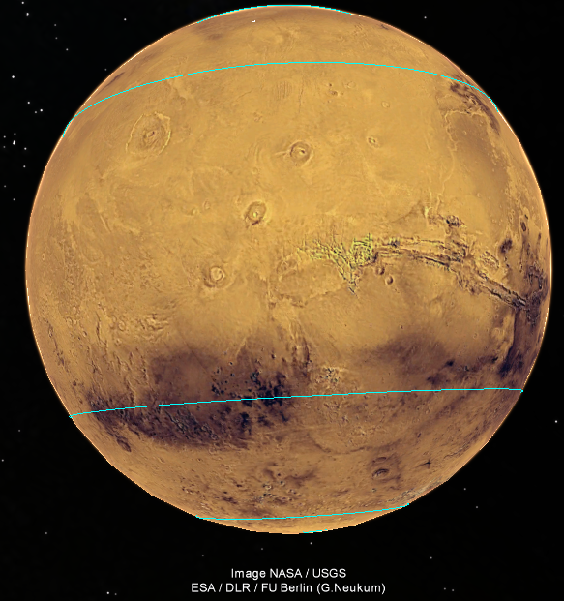

Introduction
The Tharsis Volcanic area is one of the most striking features in our solar system.

Slide 3
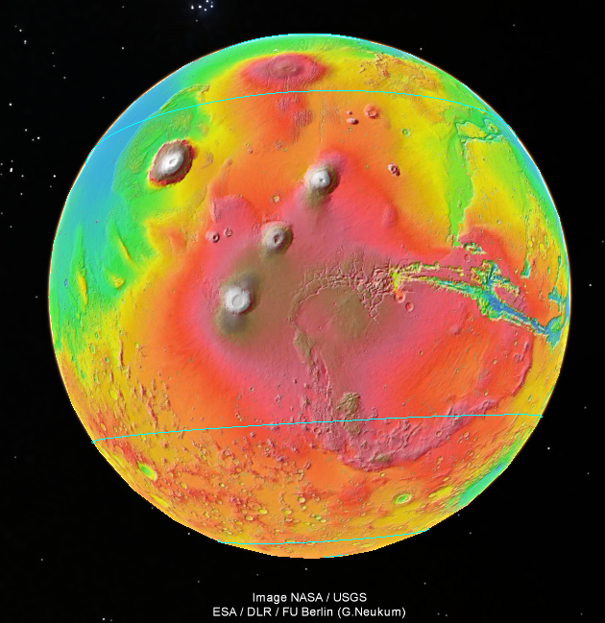
Introduction
The Tharsis Volcanic area is one of the most striking features in our solar system.
Olympus Mons
The largest volcano in the solar system.
Valles Marinenis
Terra Sirenum

Slide 4
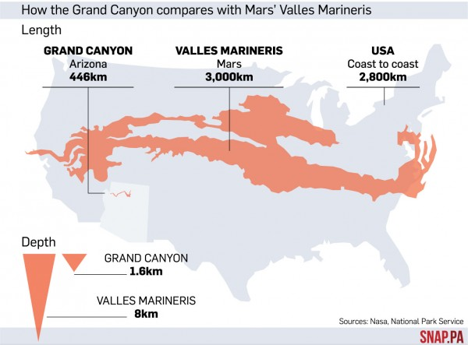
Valles Marineris size compared to the US.
http://myscienceacademy.org/wp-content/uploads/2016/05/1419256699-39419b705e141afbb853fbe697753153-600x443.jpg

Slide 5
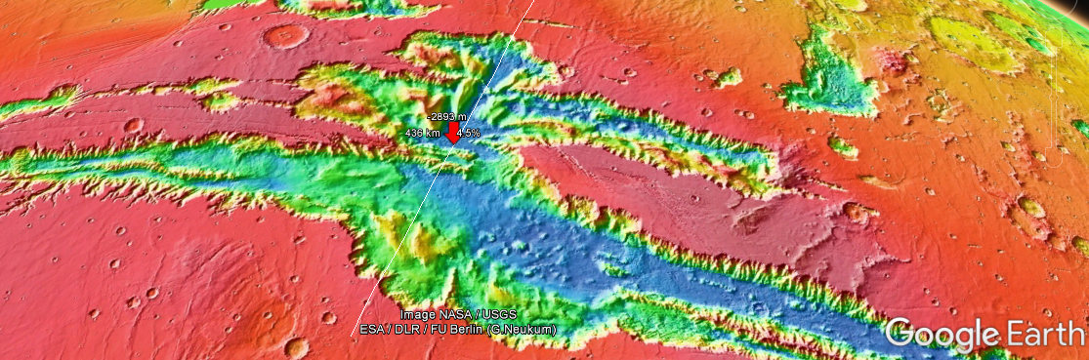
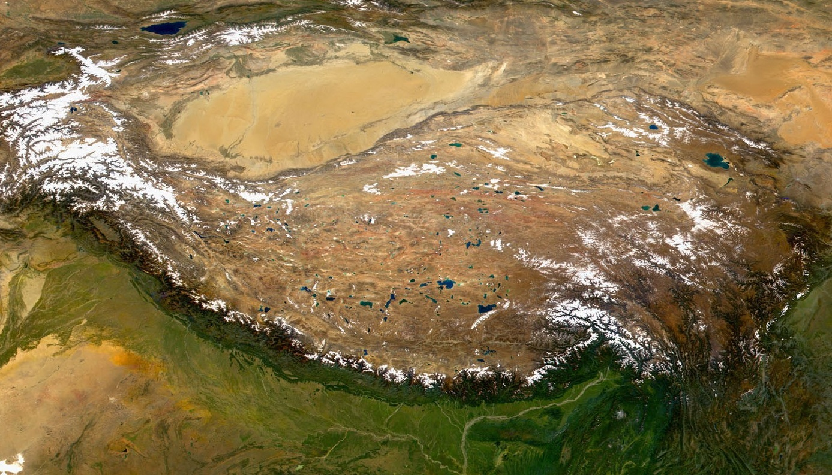
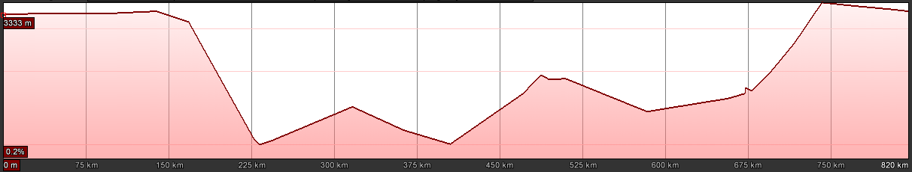
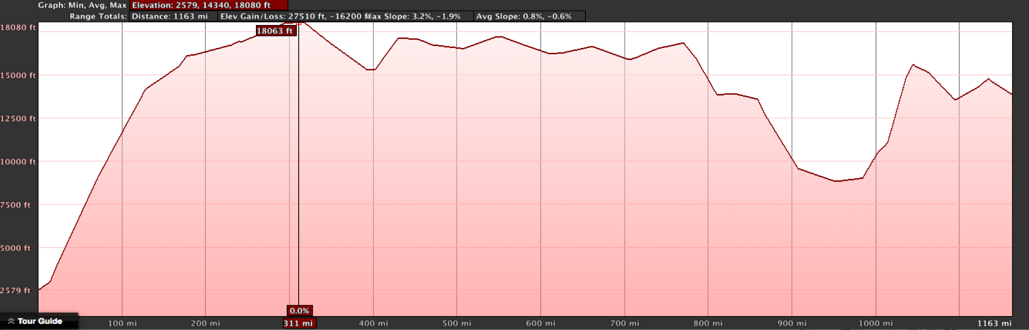
Topography of Valles Marineris compared to the Tibetan Plateau
3333 km = ~10,935,040 Feet
0 miles to 510 miles
(~46.6 mile intervals)
18,080 ft
15,000 ft
12,250 ft
10,000 ft
7,500 ft
5,000 ft
2,579 ft
0 miles to 1163 miles long (100 mile intervals)
Notes:
509 miles wide but 1000miles long

Slide 6
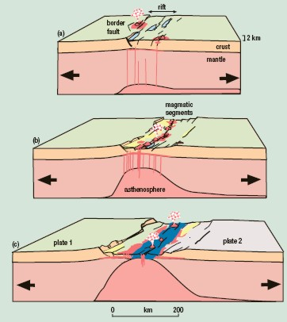
Origin of the Valles Marineris
The uplift of Valles Marineris is attributed to the large plume sphere underneath the lithosphere.
The plume’s force and temperature caused the rocks to expanded across the region, and fractures were created.
The rocks expansion in the lithosphere also created the rift valleys from basaltic magma, causing decompression of the mantle and plume.
Finally, the magma rocks hypothetically formed by the Tharsis region erupted into the fractures and molded Valles Marineris.
Example of rift formation on Earth
Introduction to Planetary Science, The Geological Perspective

Slide 7
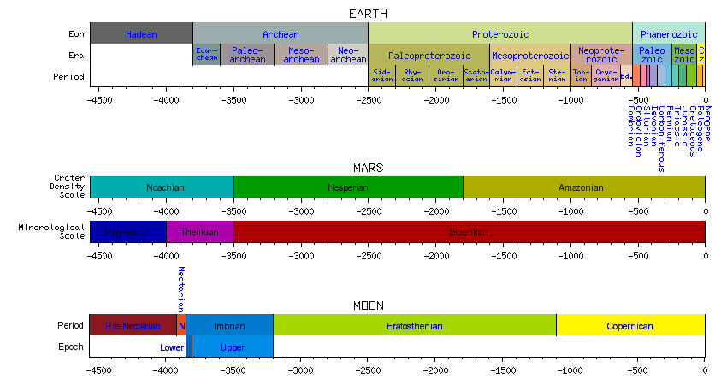
Mars Had Water in the Past
In the Hesperian and Noachian period, Mars had its own hydrological cycle.
The formation of Valles Marineirs and the water cycle happened at different geological time periods.
The water evaporated into the atmosphere, which brought precipitation into northern hemisphere.
Melted snow and rain created ice caps, which made the stream networks freeze up and in the process drying up the topography.
Greenhouse gases were decline and the hydrological cycle diminished.
Public Domain, From Wikipedia
Introduction to Planetary Science, The Geological Perspective

Slide 8
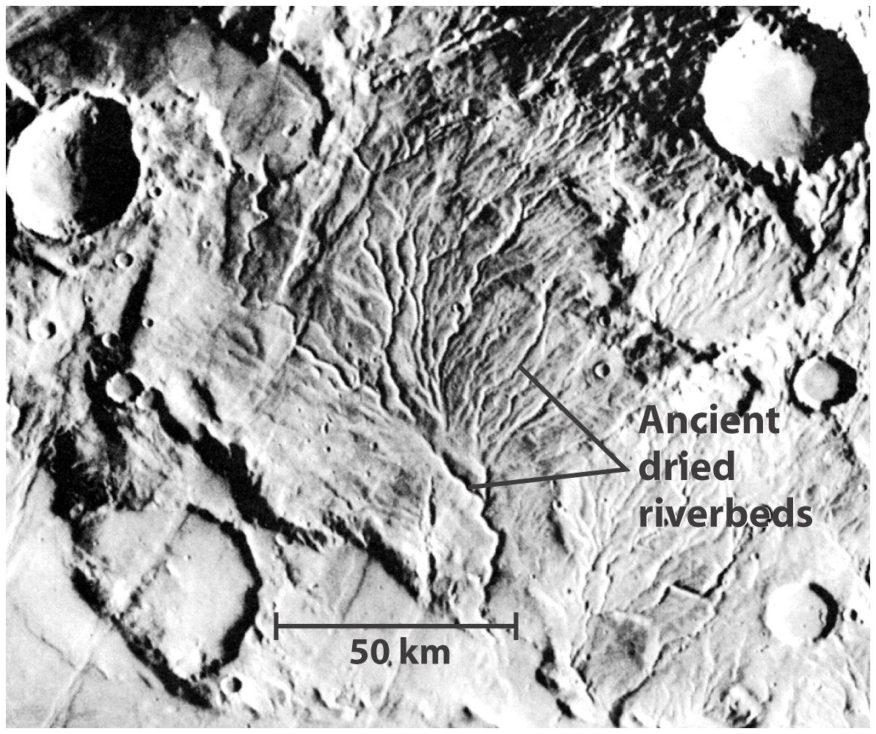
No liquid water or rainfall on the planet’s surface today
However, liquid water once flowed on Mars, as evident in many surface features

Slide 9
Research question:
The mapping and characterization of the drainage network, correlated to the tectonic characteristics of the region will shed light on the dominant factors controlling the evolution of the canyons.

Slide 10
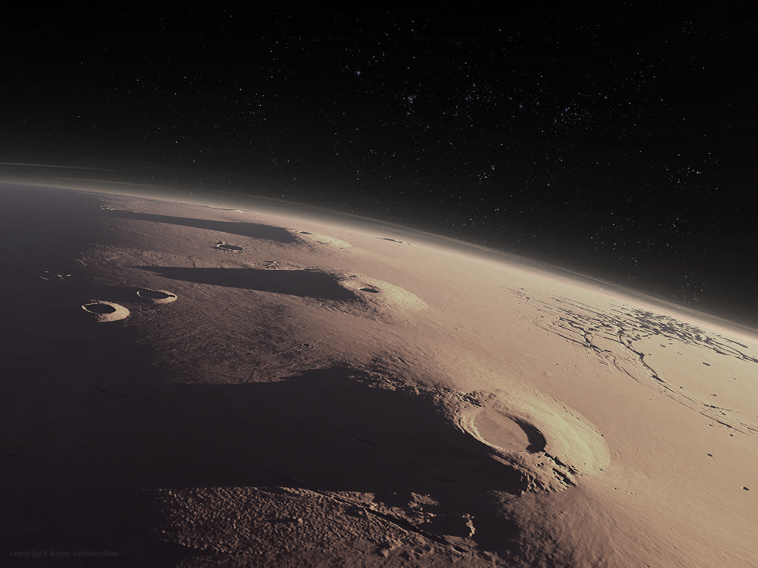
Methods
Digital processing of MOLA DEMs to extract drainage network.
Mapping of lineaments (believed of geological origin) on maps derived from DEM
Comparison of drainage network and lineament map to prove influence of geology.
In this study, digital processing of MOLA digital elevation models were used to characterize the drainage basin of the Tharsis volcanic region. Lineaments of tectonic origin were mapped using several digital models derived from the MOLA DEM. Drainage network characteristics were compared to the lineaments to determine the influence of geology on its configuration. Drainage basin properties were compared to basins on Earth to establish if basins on Mars are of fluvial origin.

Slide 11
Digital processing of the MOLA for hydrologic analysis
Extraction of the drainage networks using Arc-GIS
Flow direction
Flow accumulation
Flow Area
Times by Cell Size
Log10
Reclassification
Stream Order
Staher
Extraction of the stream network

Slide 12
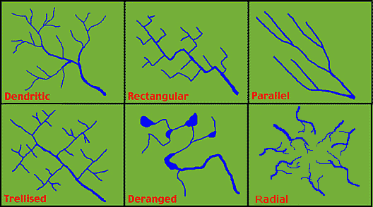
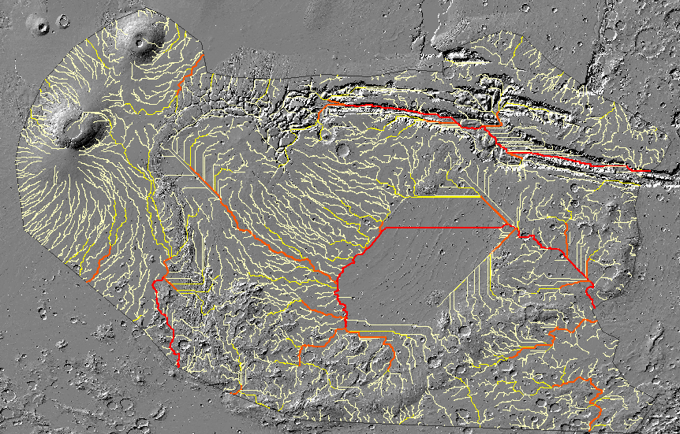
Drainage network obtained
Water Divide
Radial network
Parallel network

Slide 13
Digital processing of the MOLA for geological purposes
Slope: Measuring the incline (steepness) of a surface.
Hillshade: Shadows drawn on a map to stimulate sun’s rays.
Aspect: The compass direction that a topograpic slope faces.
Overlay: Superimposed together

Slide 14
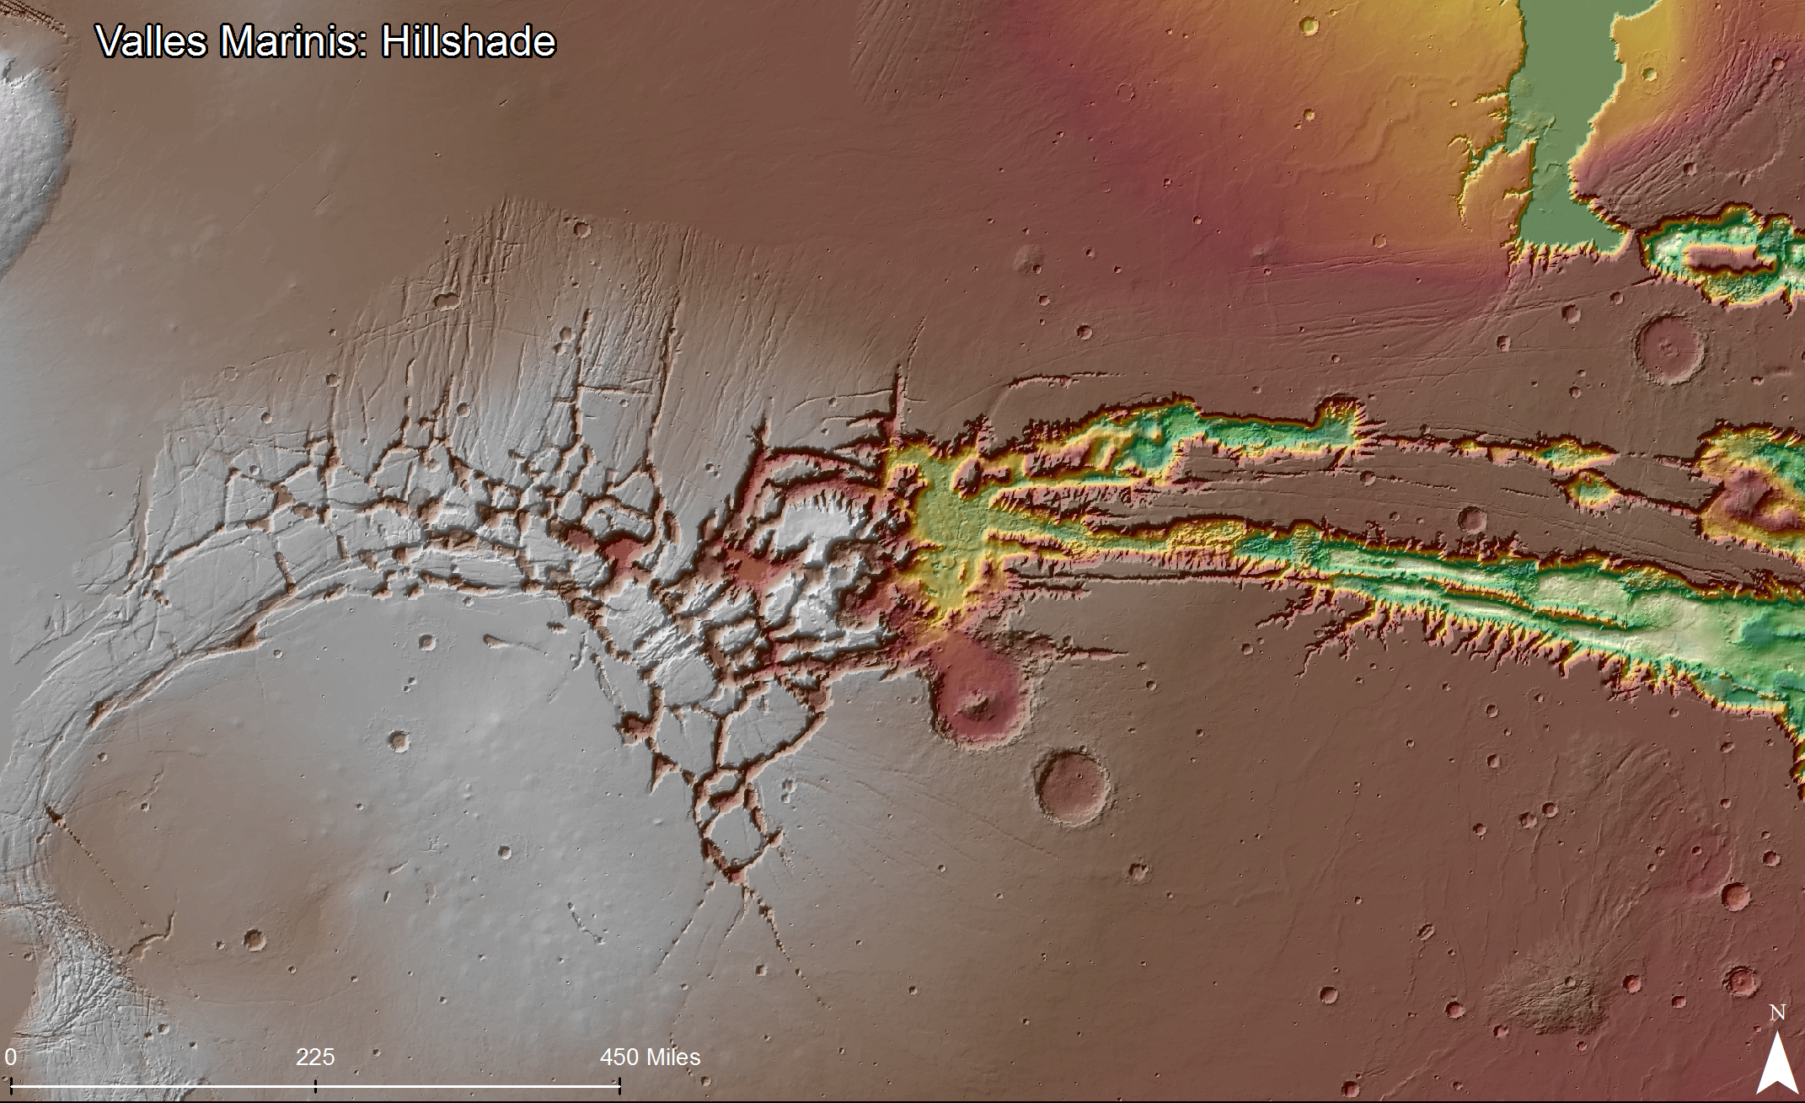
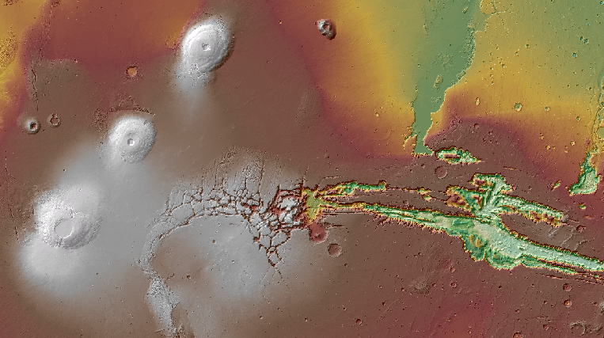
Lineaments on Hillshade DEM

Slide 15
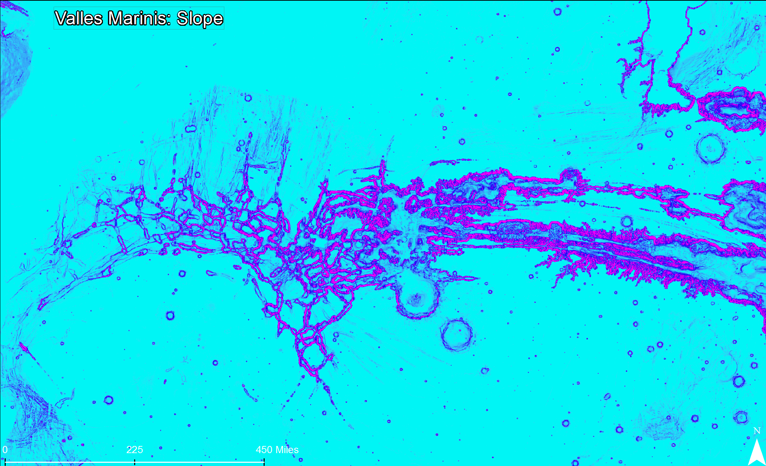
Lineaments on a Slope map derived from DEM

Slide 16
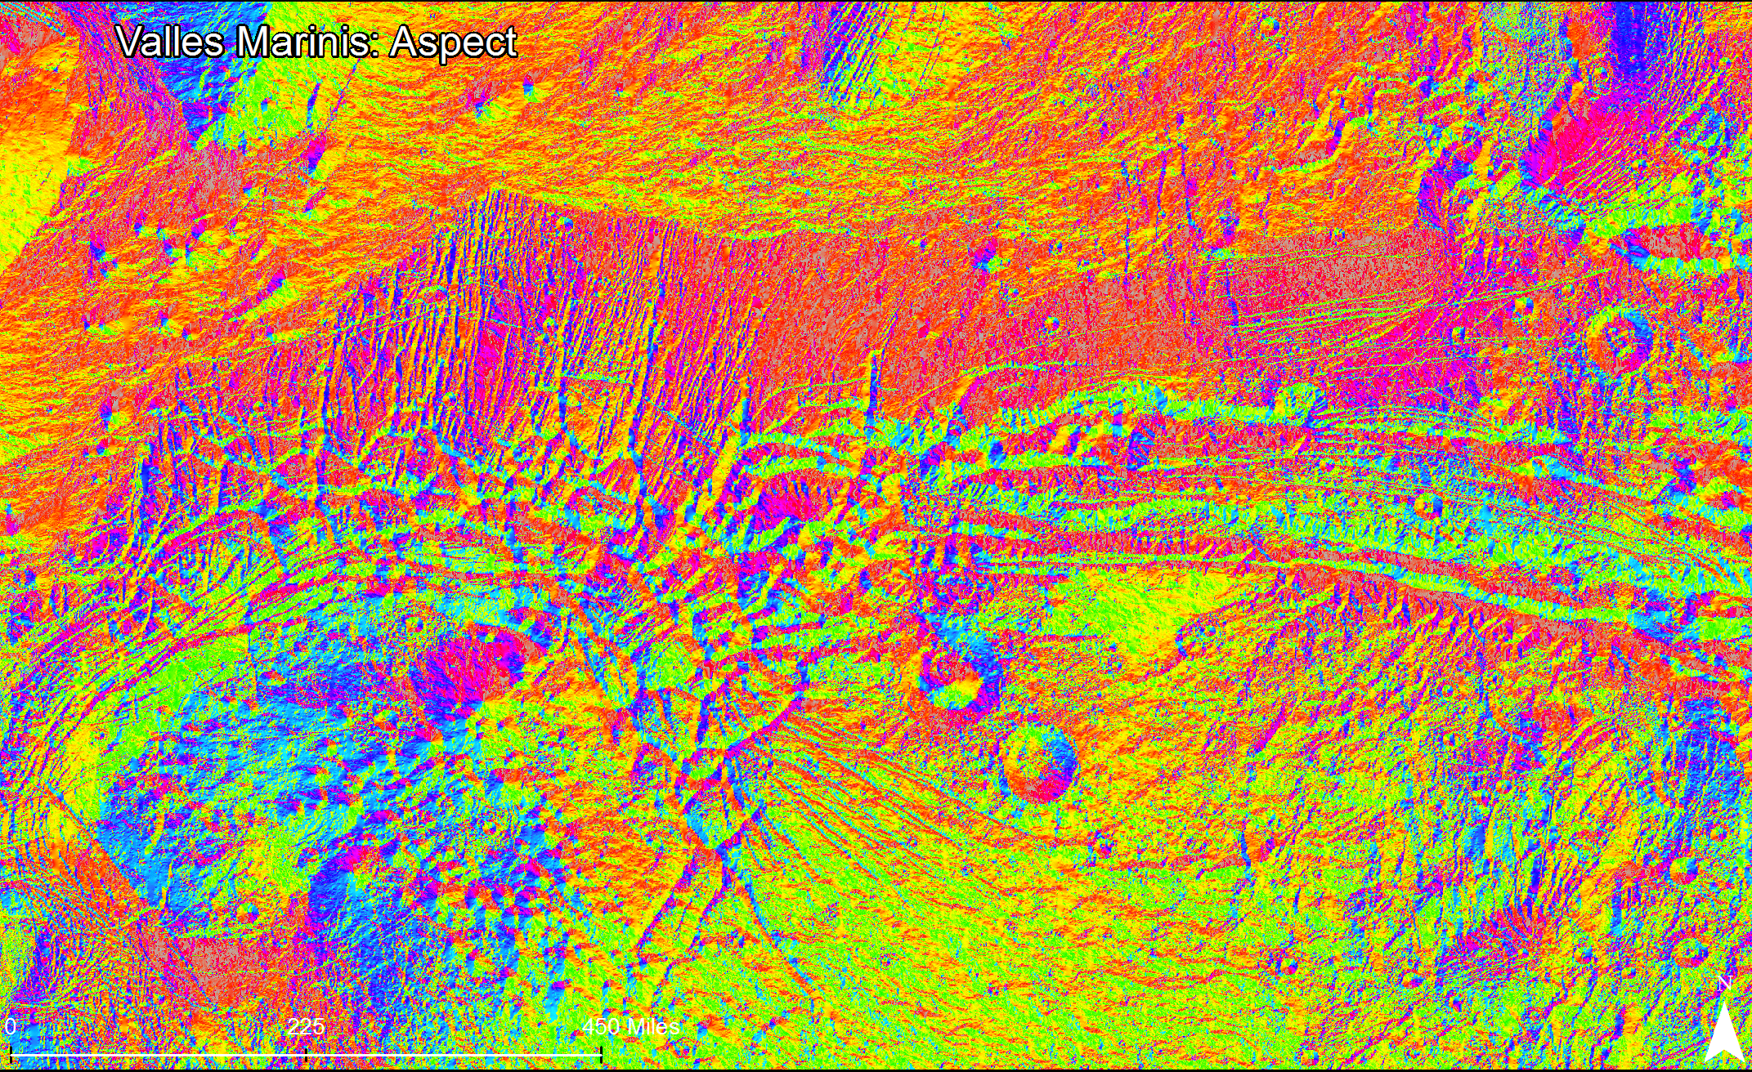
Lineaments on a Aspect map derived from DEM

Slide 17
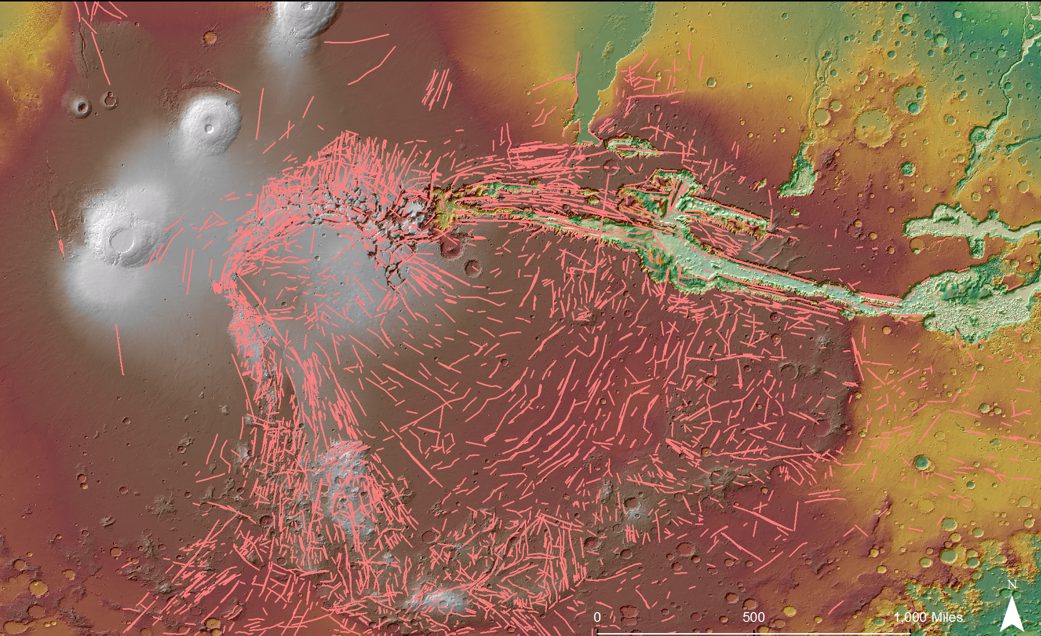
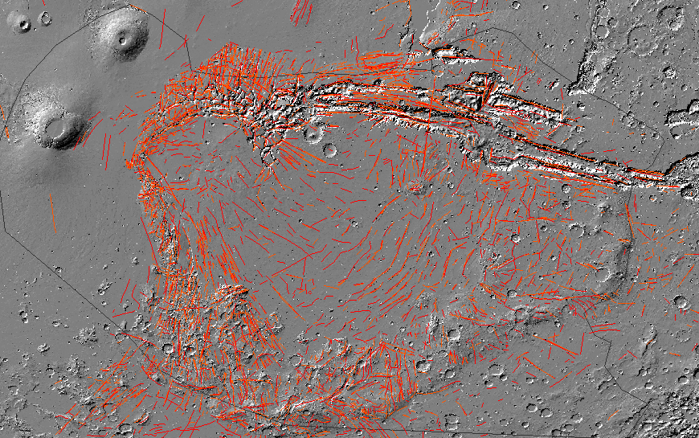
Definition of a Lineament is: A mappable linear surface features which differ distinctly from the patterns of adjacent features and presumably reflect subsurface phenomena. (O’Leary et al. 1976
Lineament Map

Slide 18
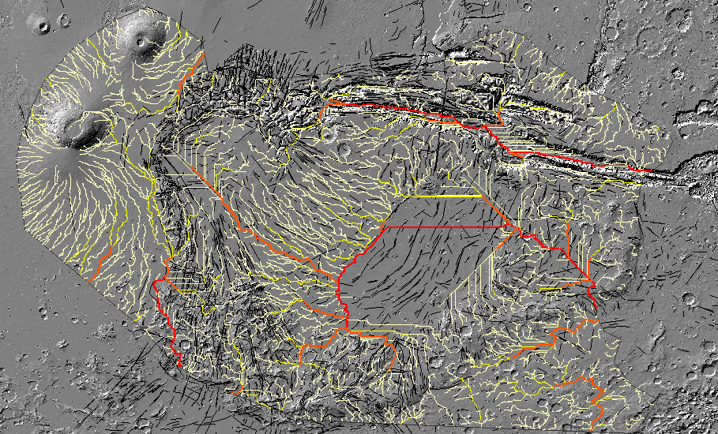
Comparison of Martian Drainage Networks to Lineaments

Slide 19
CALCULATIONS (FOR OVERLYING)

Slide 20
MAIN FINDINGS
There is not correlation between drainage network and geological lineaments on the Tharsis Area.
Geology (Faulting and fracturing) has not a played a very significant role on the development of the drainage network

Slide 21
FUTURE WORK

Slide 22
QUESTIONS

Slide 23
BACK UP SLIDES

Slide 24
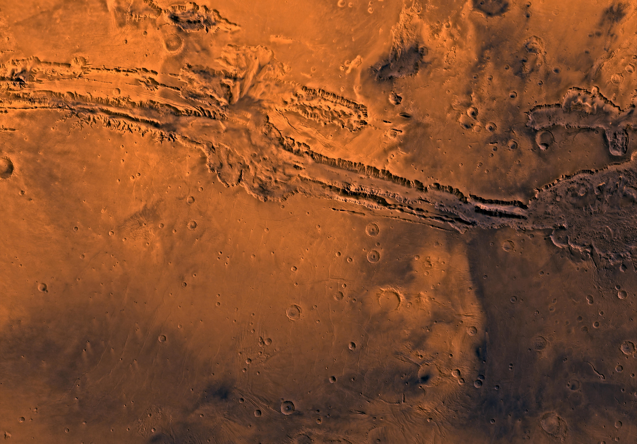

Slide 25
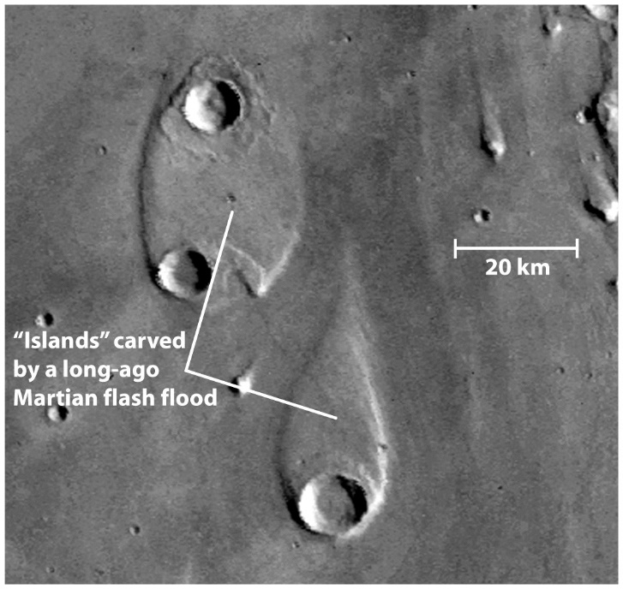
More evidence that liquid water once flowed on Mars

Slide 26
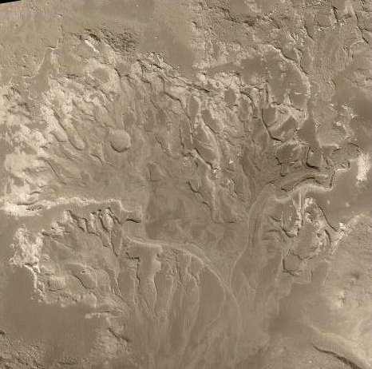
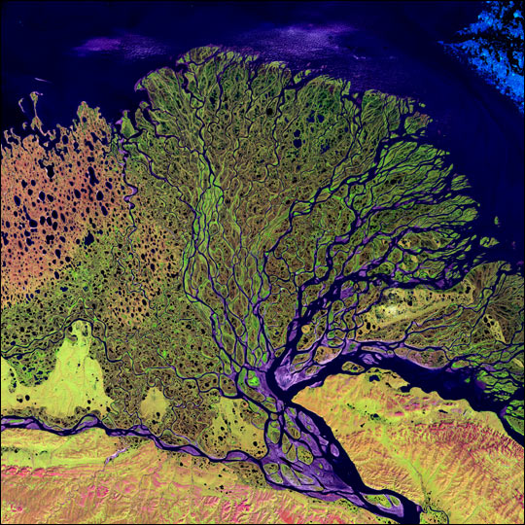
Holden Crater NE, Mars
Lena Delta, Argentina
https://www.noao.edu/noao/staff/csalyk/AST101/presentations/Mars.ppt
More evidence that liquid water once flowed on Mars

